Slide 1
WELCOME SYLVAN HILLS MIDDLE GO TEAM MEETING

Slide 2
Let’s commit to:
Wearing masks and socially distancing
Being present and engaging meaningfully so that we can learn from each other (i.e. Cameras on)
Refrain from using electronic devices unless required to engage in the work
Muting your microphone (VIRTUAL) and minimizing extraneous conversations
Assuming good will
Allowing all voices of the team to be heard
Focusing on the day’s content
Starting and ending on time
Being gracious

Slide 3
Today’s Agenda
Call to Order
Norms
Roll Call
Action Items
Approval of Agenda
Fill Open Community Member Seat
Approval of Previous Minutes
Election of Officers
Chair
Vice-Chair
Secretary
Cluster Representative
Set GO Team Meeting Calendar
Review GO Team Meeting Norms
Information Items
Principal’s Report
Announcements
Adjournment

Slide 4
GO TEAM MEMBERS 20-21
NAME | ROLE
Ms. Monica Blasingame | Principal
Ms. Jessica Bracey | Parent
Ms. Queen Rosa Harden-Green | Parent
Mr. Mark Gresham | Parent
Ms. Sade Miller | Staff
Mr. Derwin Purnell | Staff
Ms. Sonjyia Bryant | Staff
Ms. Keisha Mackey | Community Member
VACANT | Community Member
Ms. Johna Rhooms | Swing Seat

Slide 5
Action Items
.
Action Items
Approval of Agenda
Fill Open Community Seat (TBD)
Approval of Previous Minutes
Vote on Officers
Vote on GO Team Calendar
Set Next GO Team Meeting Date

Slide 6
GO Team Calendar…
DATE?
TIME?

Slide 7
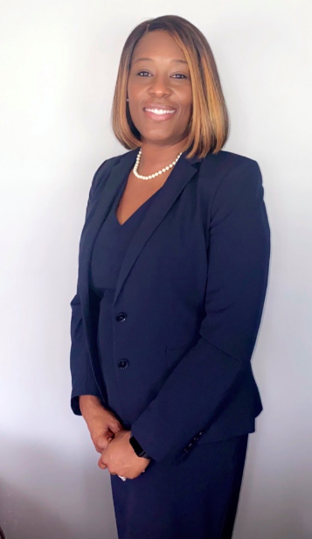
PRINCIPAL’S REPORT
New To The Den
School Priorities
Attendance Data
Engagement Data
Virtual Zapping Zeros
Reopening Update
We’ve celebrated:
Breast Cancer Awareness
Red Ribbon Week

Slide 8
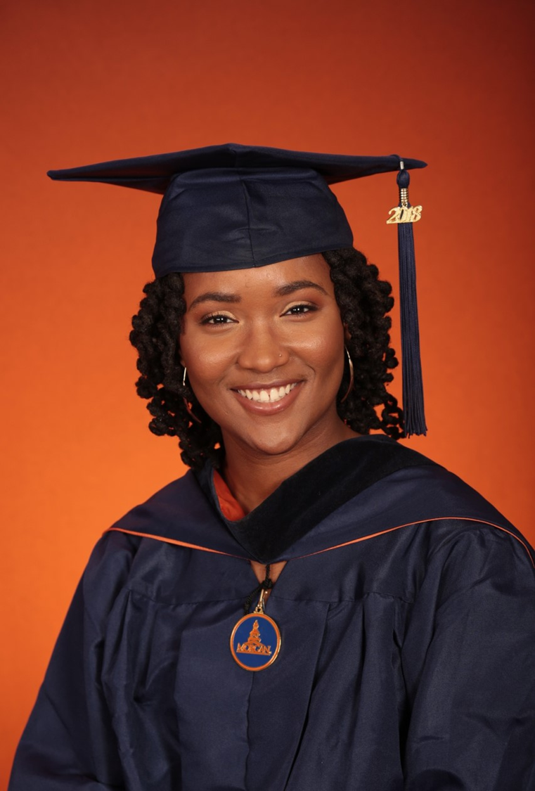
New Golden Bears to the Den!
New Golden Bears to the Den!
Born in East Palo, CA but raised in Omaha, NE
Morgan State University
1st year teacher
Likes to paint, draw and take photographs
8th Grade Science and Social Studies IRR
"Welcome to our home where we treat family like friends and friends like family."

Slide 9
Sylvan Hills Middle (Carver Cluster)
District Mission & Vision
Cluster Mission & Vision
School Mission & Vision
With a caring culture of trust and collaboration, every student will graduate ready for
college and career.
A high-performing school district where students love to learn, educators inspire, families engage and the community trusts the system
Through a culture of collaboration, respect, and trust, the Carver Cluster will enhance and strengthen its overall academic programs while maintaining a sage and nurturing environment that prepares students for college and careers.
The Carver Cluster will produce high-performing, college and career ready students that are globally aware and ready to have a positive impact on society.
It is our mission to provide a learning environment that ensures high expectations for all of our scholars through quality instruction, real-world applications and technology that promotes and fosters knowledge and skills.
Sylvan Hills Middle School will provide a nurturing and safe environment where scholars become critical thinkers, problem solvers, lifelong learners, and productive citizens.
Signature Program: College And Career Prep
School Priorities
School Strategies
Key Performance
Measures
Cultivate a literate community in which students read and write with clarity and fluency across all contents
Improve students’ mathematics performance
Improve students’ enrollment and success in higher-level classes
1A. Develop, implement and monitor best writing practices across all contents. 1B.Implement a meaningful literacy/math block (SFA) that includes whole group instruction, flexible small group instruction and literacy work stations.
1C. Develop and implement a Response to Intervention (RTI) plan, beginning with strong first teaching and targeted intervention.
1D. Implement Definitions of Teaching Excellence
2A-E. Same as 1B-1F
2F. Implement weekly common assessments
2G. Focus on unit assessment performance
3A. Develop master schedule aligned with student data, needs, and high school course offerings
3B. Offer more courses that will earn high school credits
Increase students performance on GA Milestones in Reading, Writing, and Math.
Increase student performance on STAR Assessment.
Increase students performance on 4sight reading assessment (quarterly).
Improve performance on district benchmark assessment
Improve NAEP scores (8th grade only)
Increase the number of parents and community members that participate in local and state administered surveys.
Increase TKES evaluation scores
Increase overall CCRPI rating
Improve students’ attendance
Improve culture and climate ratings
Academic
Program
Foster a culture of ongoing support for teacher development.
Recruit and maintain highly talented faculty/staff trained in researched-based best for developing the total middle school student (academically, socially, and emotionally)
4A. Identify teacher growth opportunities to provide ongoing coaching support.
Communicate clear expectations and feedback to teachers.
4B. Consistently implement revised teacher induction program for staff new to Sylvan.
4C. Provide ongoing valuable staff development designed to help staff elevate the rigor in the classroom and help students utilize higher order thinking, reading and writing skills.
5A. Establish and maintain incentive program to reward faculty and staff who consistently demonstrate the highest standards of professionalism.
Talent
Management
Engage all facets of the community as partners and align people and resource to maximize impact.
6A. Build relationships between school leadership/staff and partner leadership in order to better serve the needs of the Sylvan Hills community.
6B. Strengthen family and community support to increase parent involvement.
6C. Establish and maintain communication with the community about formal and diverse engagement opportunities at Sylvan Hills.
6D. Offer ongoing surveys to students, staff, and parents to determine needs and current awareness of existing programs and community resources.
Systems &
Resources
Provide increased teaching and learning opportunities for all staff and students.
7A. Implement Social Emotional Learning (SEL) daily.
7B. Utilize the services of the Northstar Psychological Services and other providers to assist students/families.
7C. Create a culture to support and encourage our students to behave in a positive manner where they all can learn and feel protected in a safe and orderly environment
Culture

Slide 11
SCHOOL PRIORITIES
2020-2021 SCHOOL PRIORITIES

Slide 12
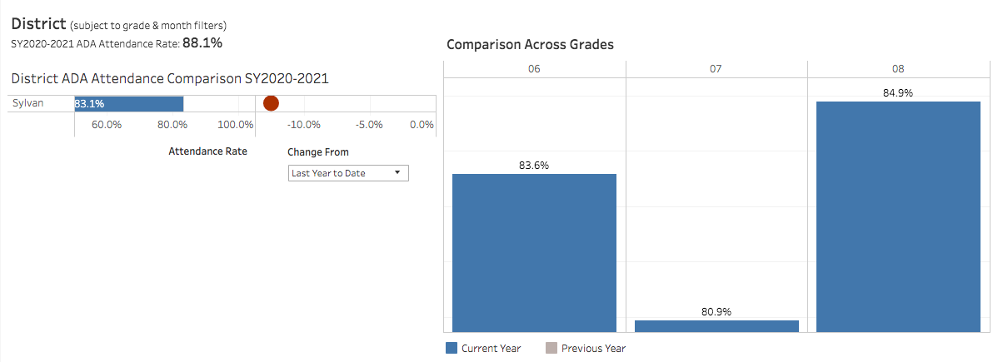
ATTENDANCE DATA

Slide 13
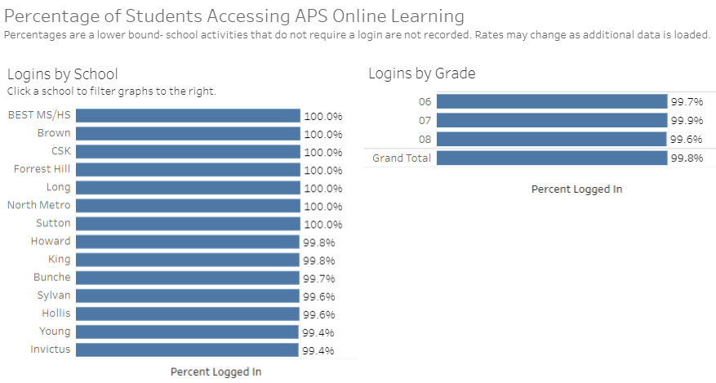
ENGAGEMENT DATA

Slide 14
ZAP ZEROES
MAKING SHMS A FAILURE FREE ZONE
Situation: Online Learning can be extremely taxing on students.
Problem: Trend data shows that our scholars participate in virtual instruction all day and crash once the school day is complete.
Solution: Scheduled Amnesty Days, which will allow for students to make-up missing assignments during the school day.
Intended Results: Students’ grades improve for the 2nd 9 weeks and failure rates will decrease.

Slide 15
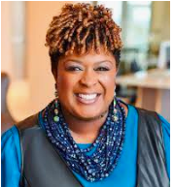
What’s New From Dr. Herring?
Atlanta Public Schools (APS) will postpone all reopening plans for in-person learning until January 2021.
DATA
MOVING FORWARD
Athletics - high school football, volleyball, softball, and cross country teams will continue to compete; no fans are allowed in the stands; winter athletes to begin conditioning soon
Employee Telework Process and Access to Schools and Buildings - please maintain current schedule until further notice.
Anyone with a telework application currently in process for Phase II reopening should complete the process to have their approval or denial documented for future reference.
Current average of positive COVID-19 cases exceeds 130 new cases per 100,000 county residents. https://dph.georgia.gov/covid-19-daily-status-report
16,200 families that did not return the intent forms, defaulted to site-based virtual instruction.
To date, 39% of teachers requested telework.

Slide 16
ANNOUNCEMENTS!
For updates and more information regarding school events, visit the school’s website!

Slide 17
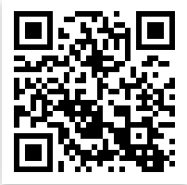
Connect with US!
@apssylvanhillsms
https://www.atlantapublicschools.us/Page/4020
@apssylvanhills

Slide 18
Questions?
Feedback?
Concerns?

